Slide 1
My Singapore Experience
Sharing on TF Intl LEaRN Forum
Li Yanzhang
2018.10.17

Slide 2
Contents
Community Service
Differences between SUTD and ZJU

Slide 3
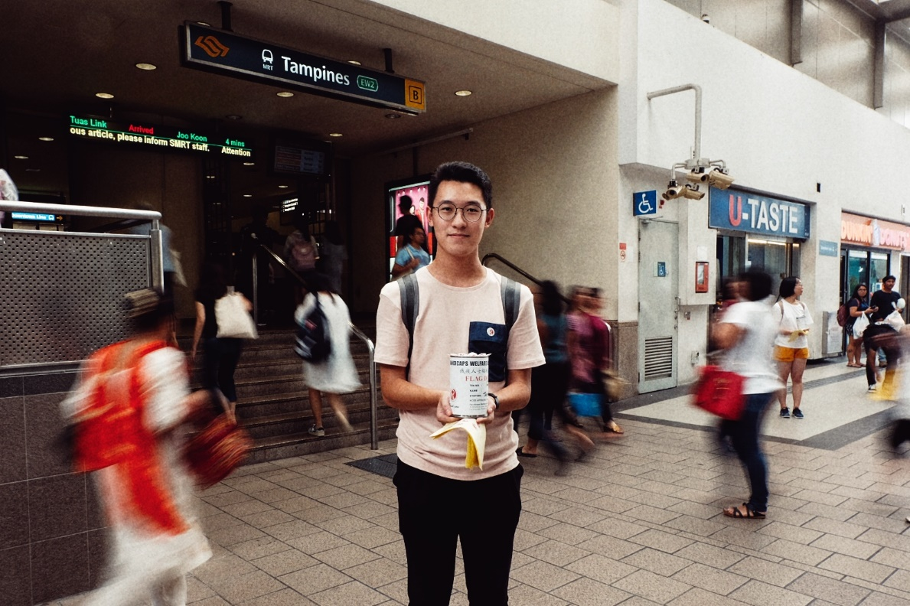
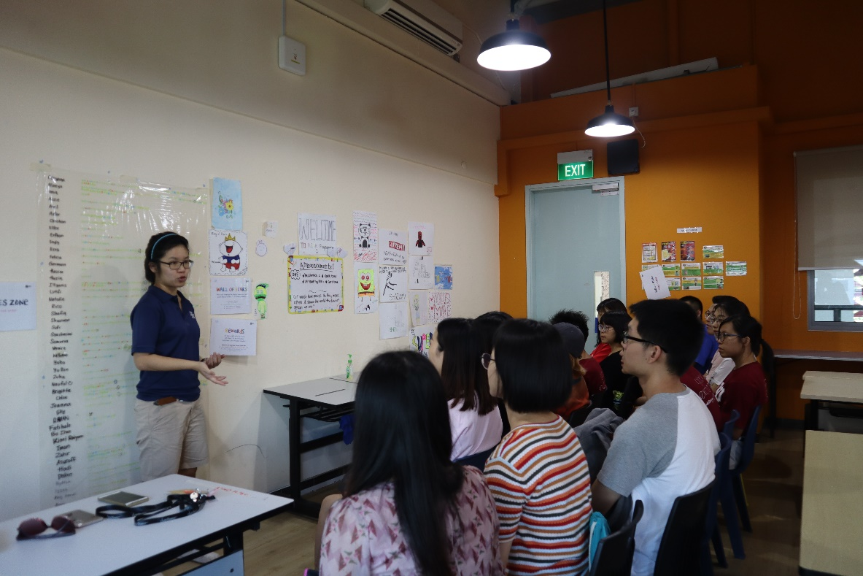
Community Service
Handicaps Welfare Association Flag Day
Youth Engaged At Heartland Programme

Slide 4
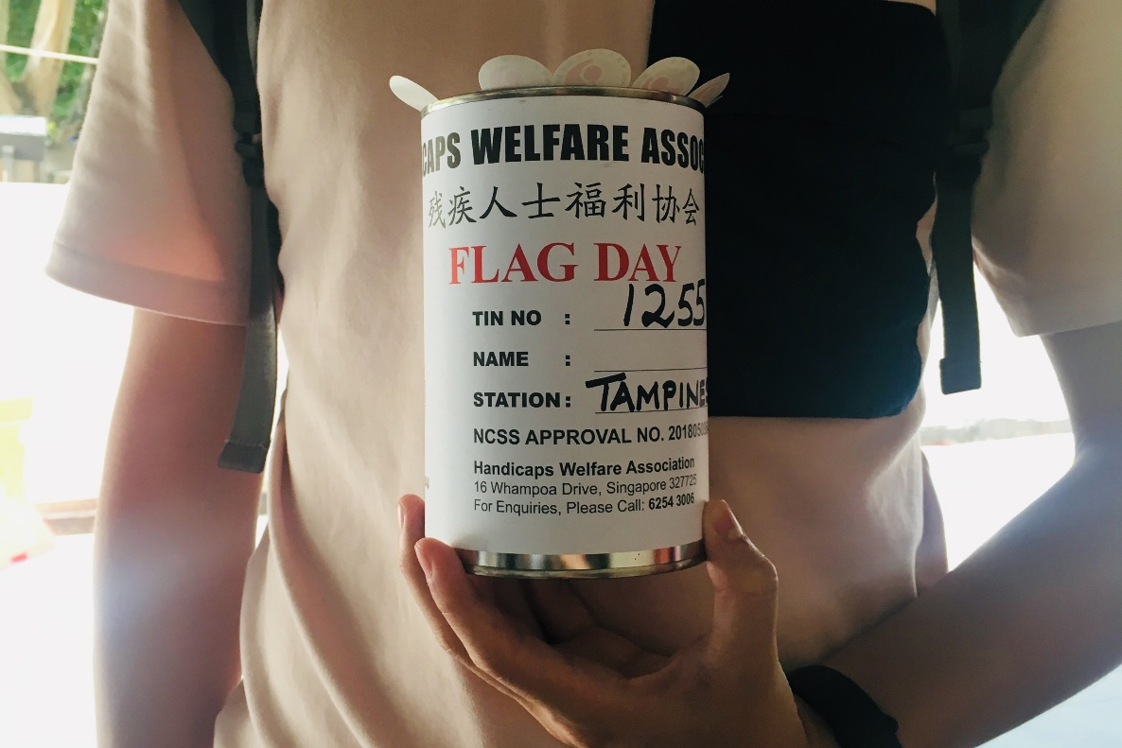
Community Service
Handicaps Welfare Association Flag Day

Slide 5
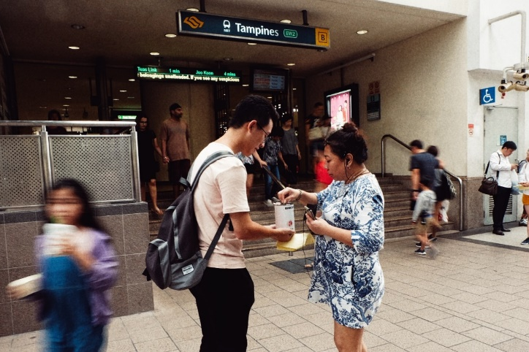
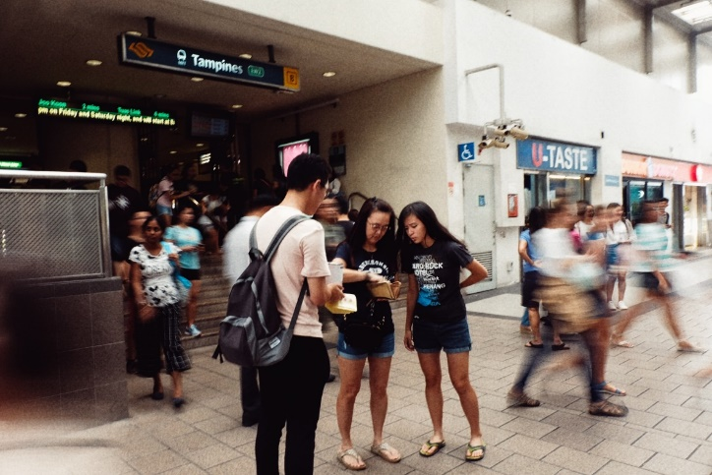


Community Service
Handicaps Welfare Association Flag Day
?
Good Reward System
Trust the Fund Raising System

Slide 6
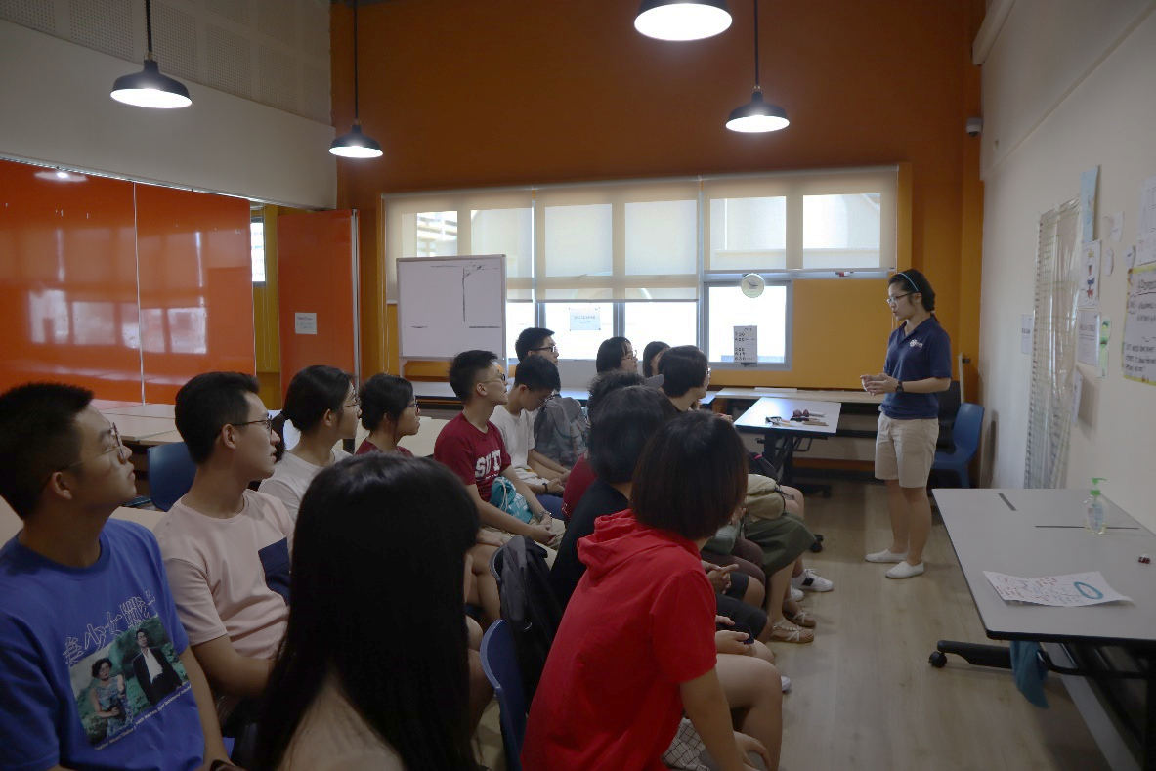
Community Service
Youth Engaged At Heartland Programme

Slide 7
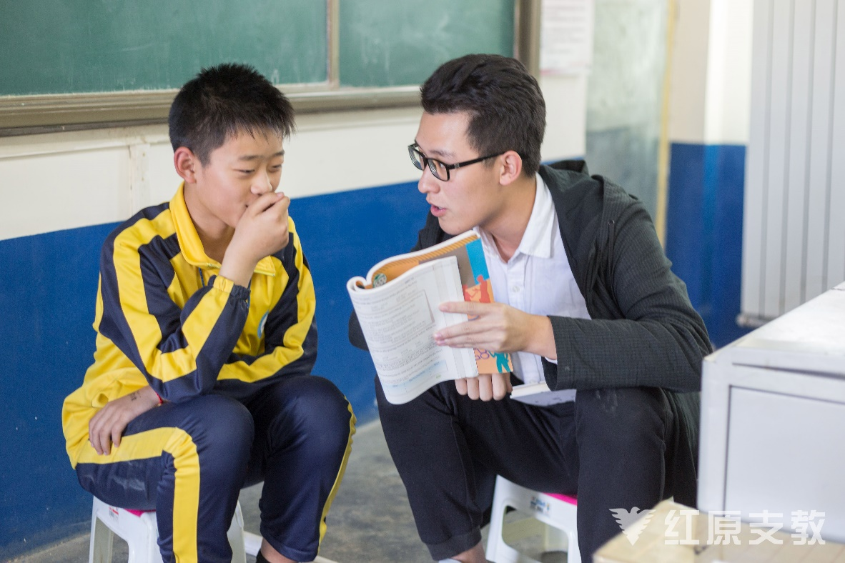
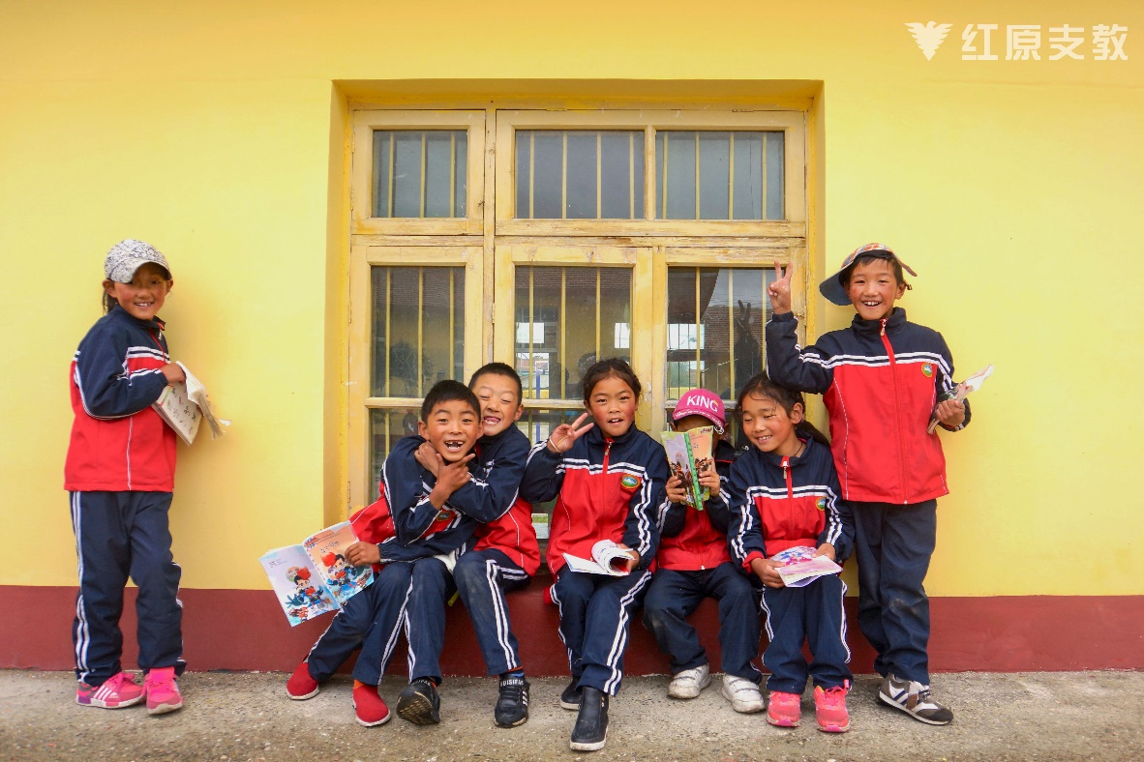
Community Service
My Previous Volunteer Experience vs. YEAH Program

Slide 8



Community Service
The future development of cities and city residents

Slide 9






SUTD and ZJU
Singapore and China
……
……

Slide 10
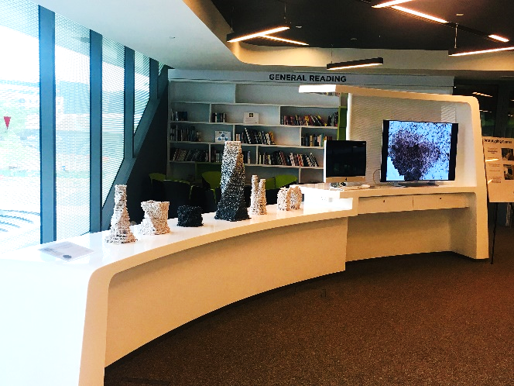
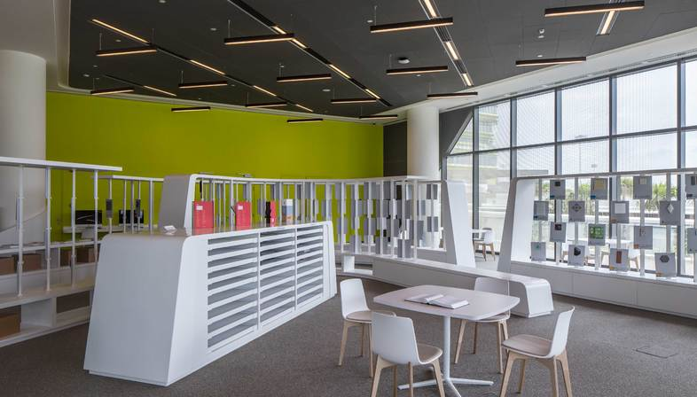
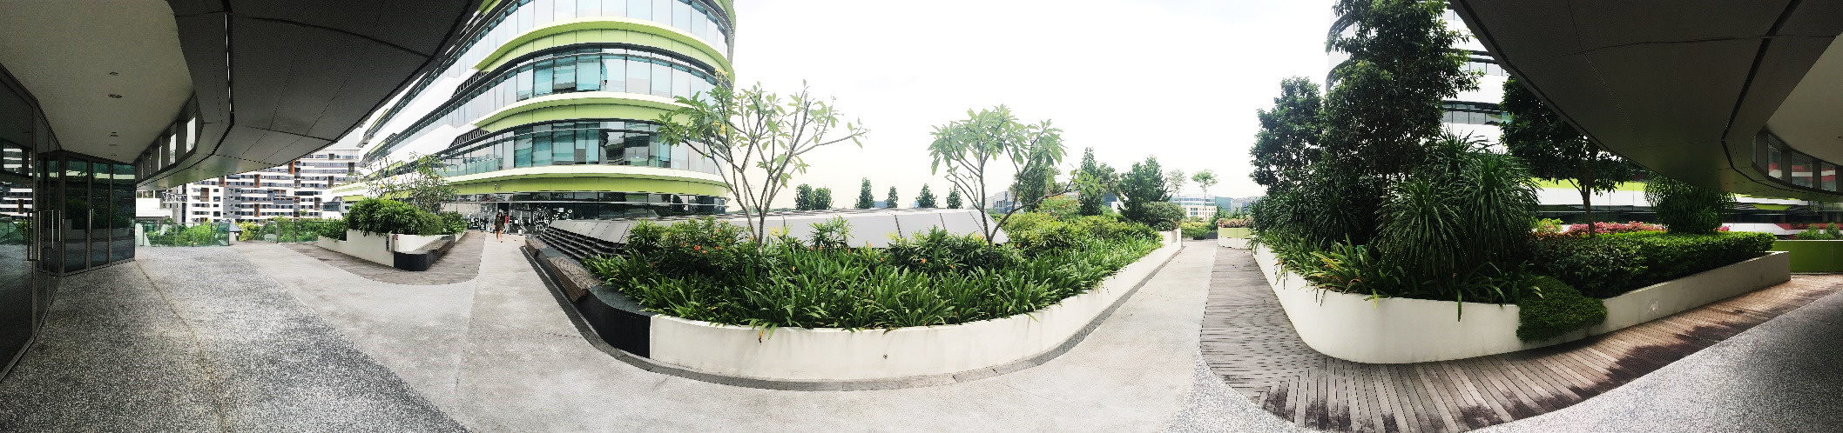
SUTD and ZJU
Sharing Places in SUTD

Slide 11










SUTD and ZJU
Capstone Project vs. Personal Thesis or Work

Slide 12
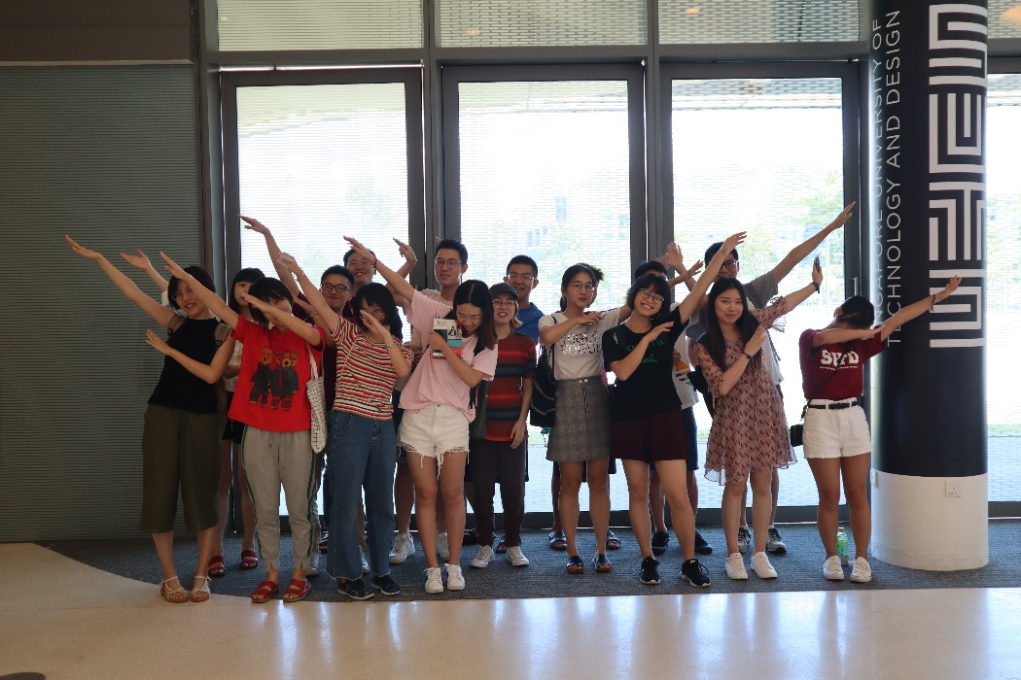
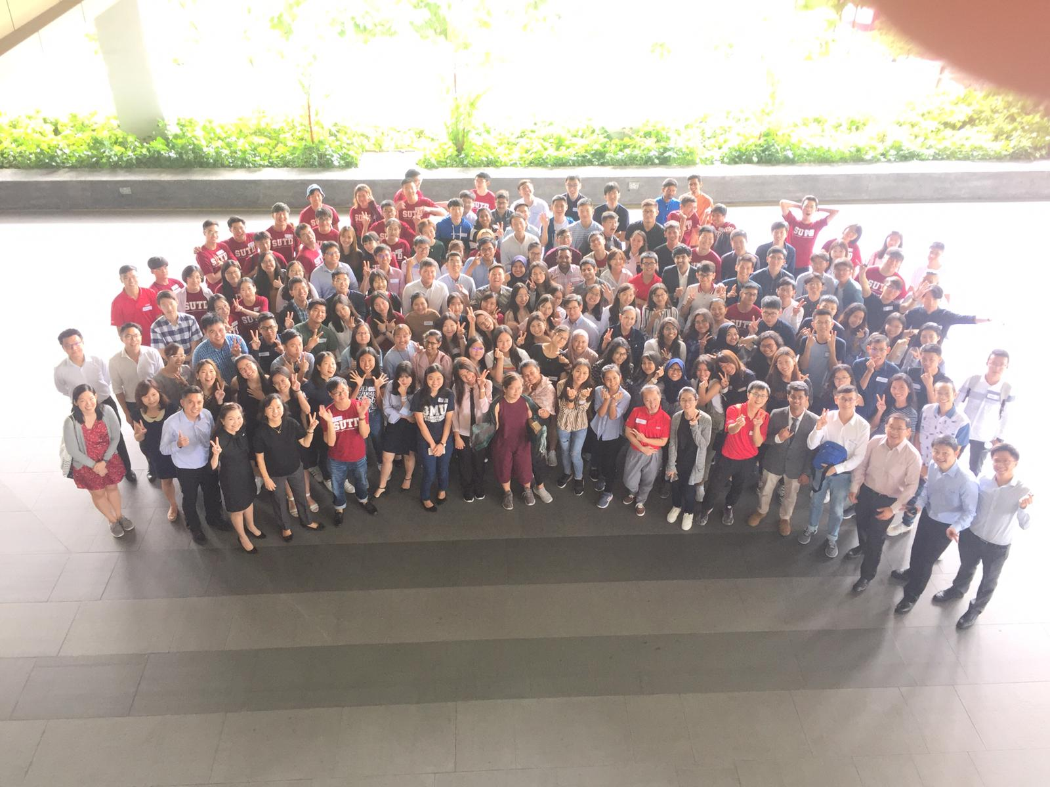
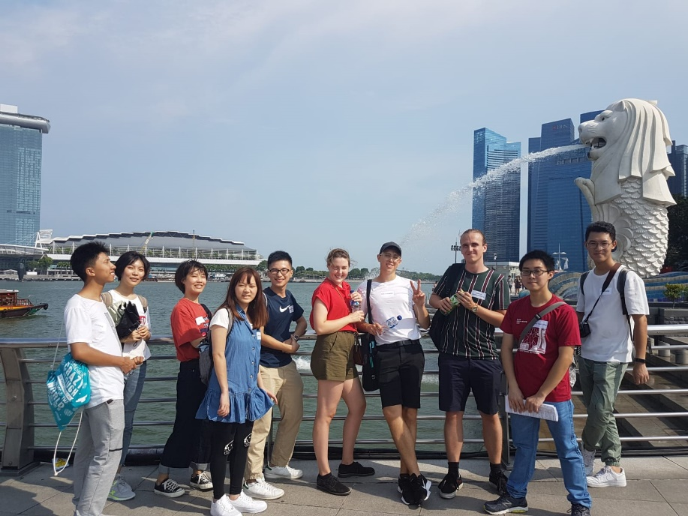
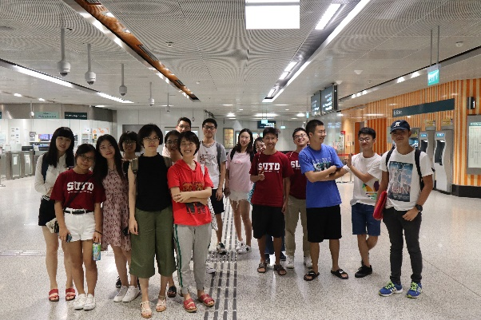
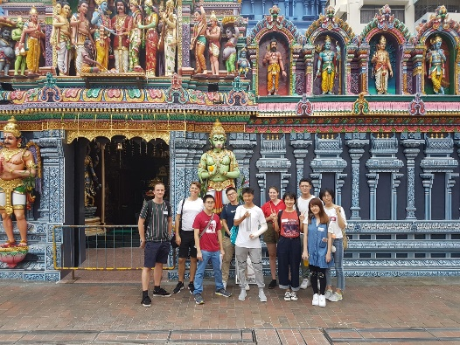
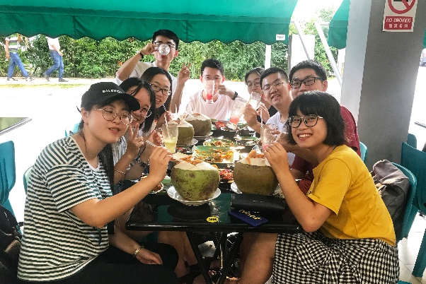
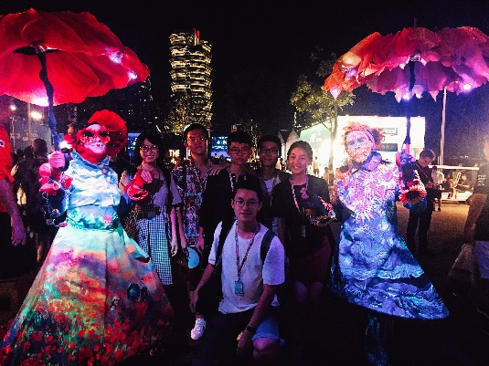
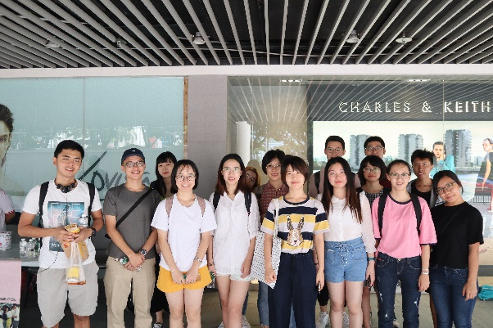
What’s more
Communication, Connection and Friendship

Slide 13
Thank You :)

